Slide 1
Qsine Application
Fall 2024 – Spring 2025 Senior Design Project by
Hung Nguyen, Eric Buffington, Kaleb Bishop, and Matthew Bryant

Slide 2
Group Members
Fred Annexstein (Advisor)
fred.annexstein@uc.edu
Eric Buffington buffinea@mail.uc.edu
Kaleb Bishop bishopkw@mail.uc.edu
Matthew Bryant bryantmw@mail.uc.edu
Hung Nguyen nguye3hv@mail.uc.edu

Slide 3

Project Abstract
QSine will be an application that allows users to photograph food items, uses computer vision and machine learning to classify what dish is in the picture, then scrape the web for recipes of that dish and return a list of common allergens that may be present.

Slide 4
User Stories
As a person with food allergies, I want to scan a menu for potential allergens so that I can confidently decide what to order without risking an allergic reaction.
As a parent of a child with allergies, I want to take a photo of a packaged food item and have the app identify any allergens so that I can ensure it's safe for my child to consume.
As a caregiver, I want to input a list of ingredients into the app to identify hidden allergens so that I can prepare meals that are safe for the person I care for.
As a user with multiple allergies, I want to be alerted to the presence of allergens and their aliases in recipes so that I can avoid unexpected allergic reactions.
As a frequent traveler with food allergies, I want to quickly analyze foreign menus for potential allergens using text or image input so that I can make safe dining choices in unfamiliar places.

Slide 5
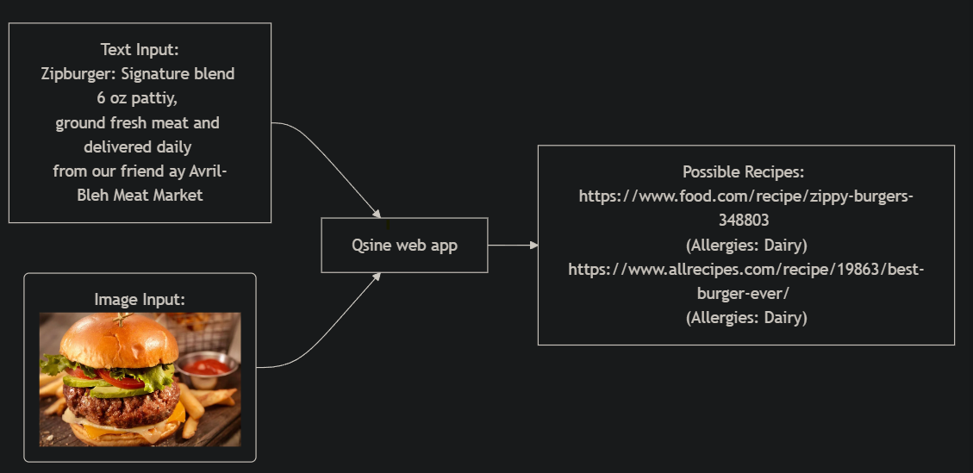
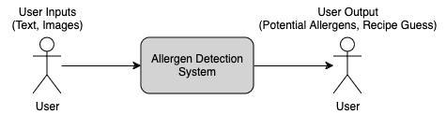
Design Diagrams: D0
D0 diagrams provide the highest-level view of the Allergen Detection System, highlighting the fundamental flow of data. Users provide inputs in the form of text (e.g., ingredient lists, menu descriptions) or images (e.g., photos of food items). The system processes these inputs to generate an allergen report, which indicates potential allergens found in the input data.

Slide 6
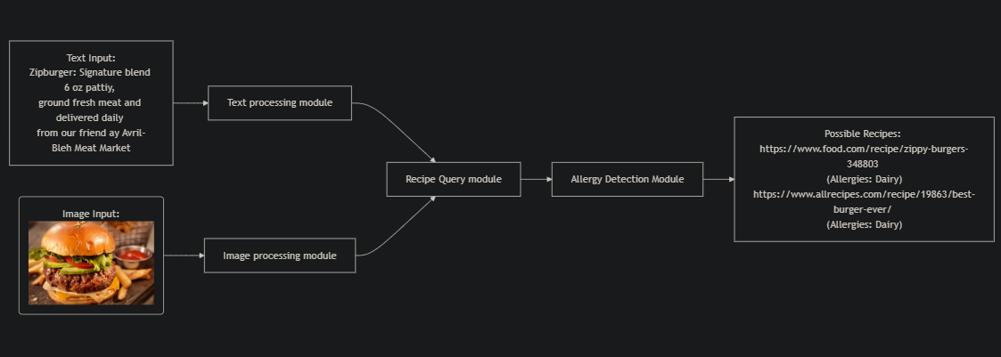
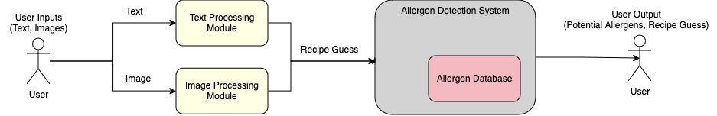
Design Diagrams: D1
Design Diagram D1 delves deeper into the Allergen Detection System, outlining its core subsystems and their interactions. This design shows the Text Processing Module, the Image Processing Module, and the Allergen Database. It details how each subsystem handles specific types of input and collaborates to provide accurate allergen detection results.

Slide 7
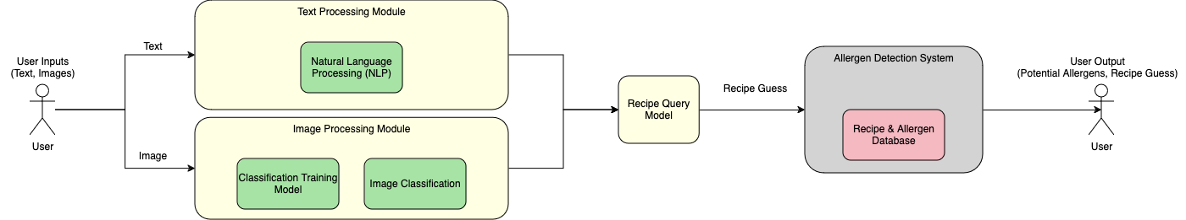
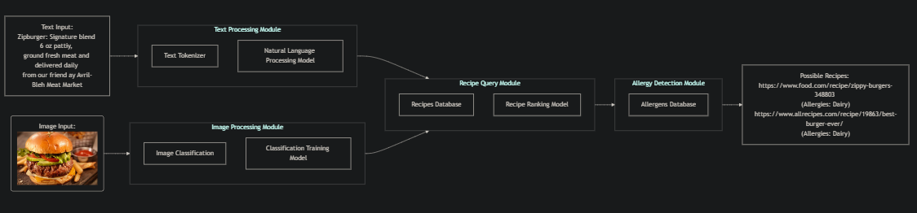
Design Diagrams: D2
Design D2 provides an in-depth breakdown of each subsystem within the Allergen Detection System, outlining the internal components and their interactions. This design highlights how data flows through various stages of processing, from initial input through detailed analysis, leading to the generation of an allergen report.

Slide 8
Major Project Constraints
One constraint that we see is our economics where we are operating with a very small budget. We must rely on open-source tools such as TensorFlow but costly datasets, tools and computational power are out of our reach.
This project also is constrained by our professional development in that it requires the specialized skills in the realm of computer science such as machine learning, NLP, image processing, and full stack development. If our product is unable to reliably deliver correct results, it will be an unsuccessful project.
Security considerations will also be a constraint given the sensitivity of dietary information. We must ensure that all personal information is not traceable back to an individual, that all data transfers are confidential, and that all data is stored securely.
The largest constraint we have is health due to the impact of incorrect results. Posting a false negative could result in the user consuming an item that can harm them. Furthermore, a bad actor may falsify the data to make allergic recipes appear as non-allergic. Thus, transparency is our strongest tool in giving users as much information as possible to guide their choices.

Slide 9
Current state of project
All of our project deliverables were successfully finished and reviewed by our advisor, Fred Annexstein, before their deadlines.
The completed deliverables include the project proposal, which outlines our plan and objectives, as well as the formation of our team and the overall project description. We also established a team contract that defines roles, responsibilities, and expectations for each member. In addition, we have developed design diagrams to visually represent our system’s architecture and processes. Task lists have been created to organize and distribute the work efficiently, while milestones and a project timeline have been established to track our progress. An effort matrix has been used to allocate effort across tasks, and we’ve also identified key project constraints to ensure we stay within scope.

Slide 10

Expected Accomplishments for the end of this term
Text Tokenizer – Create a way for a user to type in the name of a dish and process it
Rudimentary database of common allergens
Web scraper that returns some of those common allergens present in recipes

Slide 11

Division of Work
Project Milestones and Key Responsibilities:
Kaleb Bishop (Lead App Development, Web Scraper, Model Testing):
Contact Professor, Create App, Implement Web Scraper
Train Image Classification Model, Test Performance
Matthew Bryant (Database Build & Populate):
Build and Populate Recipes Database, Rank Allergens
Eric Buffington (NLP Model Integration):
Design & Implement Text Tokenizer, Research NLP Models
Hung Nguyen (Allergen Detection & Final Testing):
Design & Integrate Allergen Detection Model, Test Outputs

Slide 12
Expected Demo at Expo
We expect to be able to display our app to take a picture of labels, or food and generate potential allergen responses
Have a few premade meals that we can take pictures of and show live, that have been well studied for allergens.
These responses should be accurate and will give a confidence score as well
Show attendees the results of our app, then compared to the studies of the food we can prove it is accurate
In addition, the app will display as much information about these allergens as possible
It will possibly display ingredients that are causing the app to find the allergens in the food

